Slide 1

Face Recognition Web App Using OpenCV
Submitted To :
Ms. Parul Chauhan
Project Guide:
Mr. Vikas Panthi
Submitted by:
Neeraj Arora (14/294)
Jagdish Verma (14/288)
Nikhil Gurjar (14/295)

Slide 2
OBJECTIVE
Objective of our web App is to create a website in which face recognition is done using OpenCV library.
The web page lets you create id on the website and let you upload pictures in the groups on website. Uploaded faces compares new photos to the existing collection to find a match.

Slide 3
Description
We are creating a web app for a college. In this student can signup and upload Pictures by acting anonymous in various groups. Alumnis of the college can see their photos after a long time. There’s a admin of this web app who can see details of each person in the images which are uploaded by users with help of face detection and recognition using OpenCV library.

Slide 4
Languages and Libraries used
Front-end : HTML, CSS, Javascript, Bootstrap library
Back-end : Python, Java
Library for face recognition : OpenCV

Slide 5

What is OpenCV ?
OpenCV (Open Source Computer Vision Library) is released under a BSD license and hence it’s free for both academic and commercial use. It has C++, Python and Java interfaces and supports Windows, Linux, Mac OS, iOS and Android. OpenCV was designed for computational efficiency and with a strong focus on real-time applications. Written in optimized C/C++, the library can take advantage of multi-core processing. Enabled with OpenCL, it can take advantage of the hardware acceleration of the underlying heterogeneous compute platform.

Slide 6
What we can do with OpenCV ?
1. Read and Write Images.
2. Detection of faces and its features.
3. Detection of shapes like Circle,rectangle etc in a image.
EX. Detection of coin in images.
4. Text recognition in images. e.g Reading Number Plates/
5. Modifying image quality and colors e.g Instagram, CamScanner.
6. Developing Augmented reality apps.

Slide 7
How website works ?
User Section
Register on the website.
Login into website.
3. Select a group.
Upload photos.
Tag peoples if they aporove your tag.
Admin Section
1.Login as admin.
2.Recognize faces of anonymous users with OpenCV library automatically.
3.Fetch whole lot of information of any user with in just one click.

Slide 8
Registration (FOR USER)
1. Go to register page by clicking register button on top right of
the home page.
2. Fill your entries and upload photos.
3. Now go to login page after your registration.

Slide 9
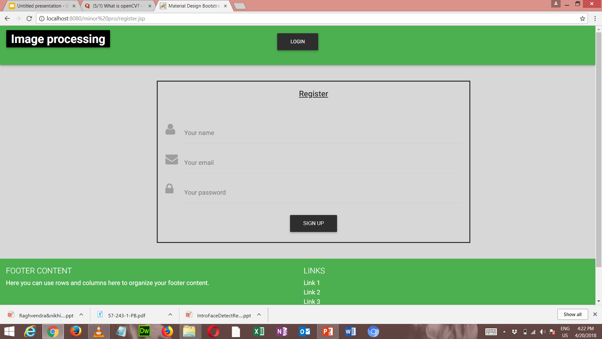
Registration

Slide 10
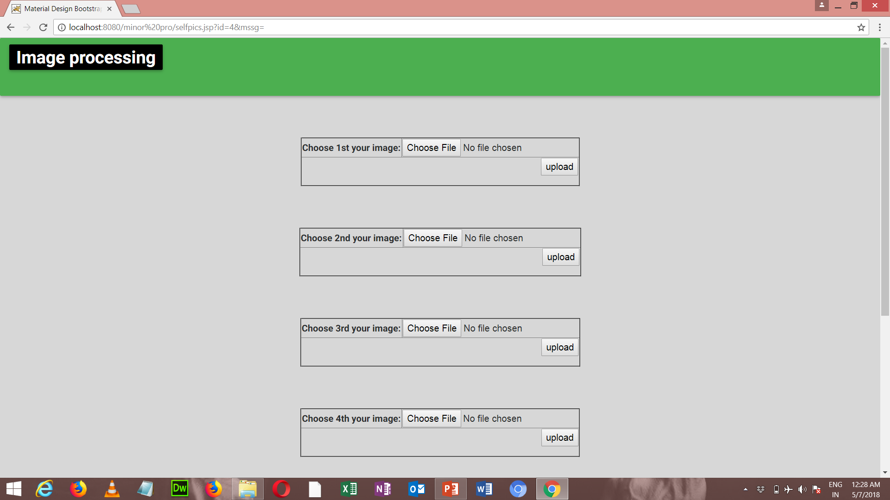
Upload 5 photos of yourself.

Slide 11
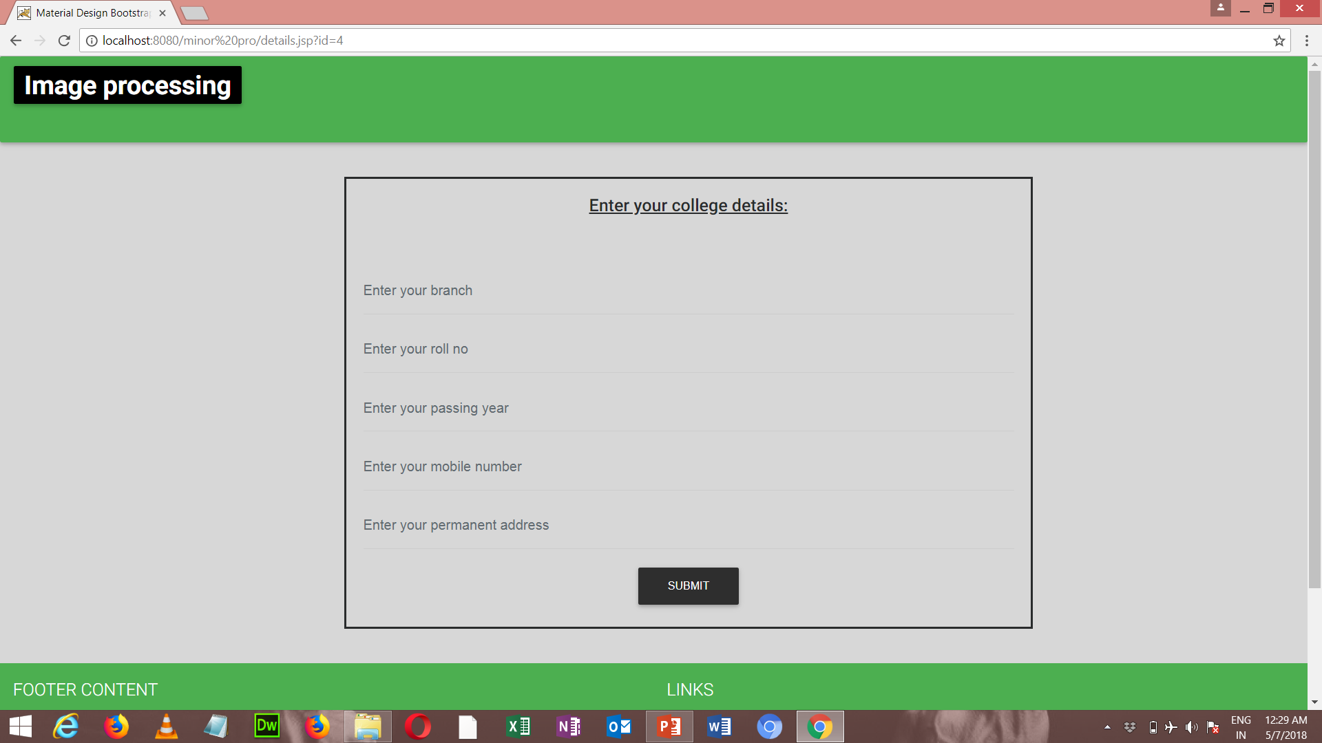
Enter your college details

Slide 12
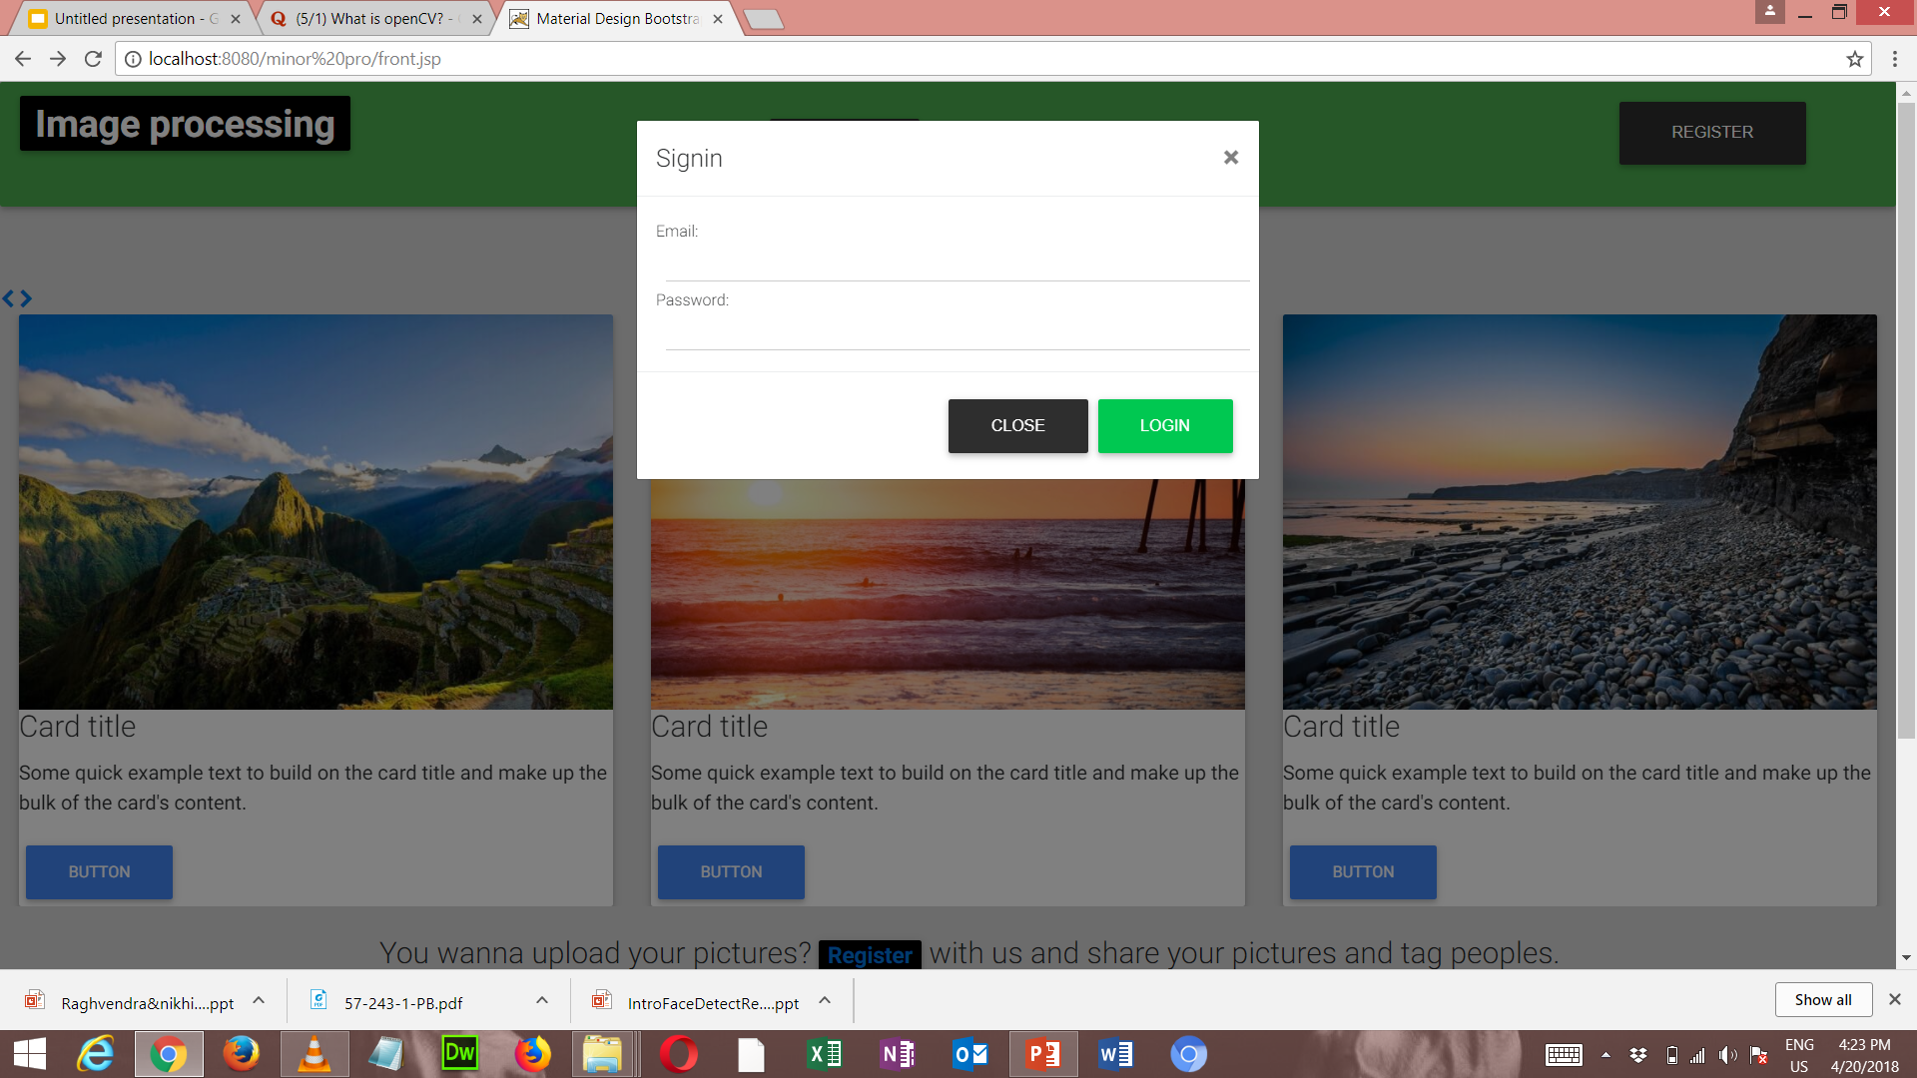
User Login
After you done with registration fill your login details.

Slide 13
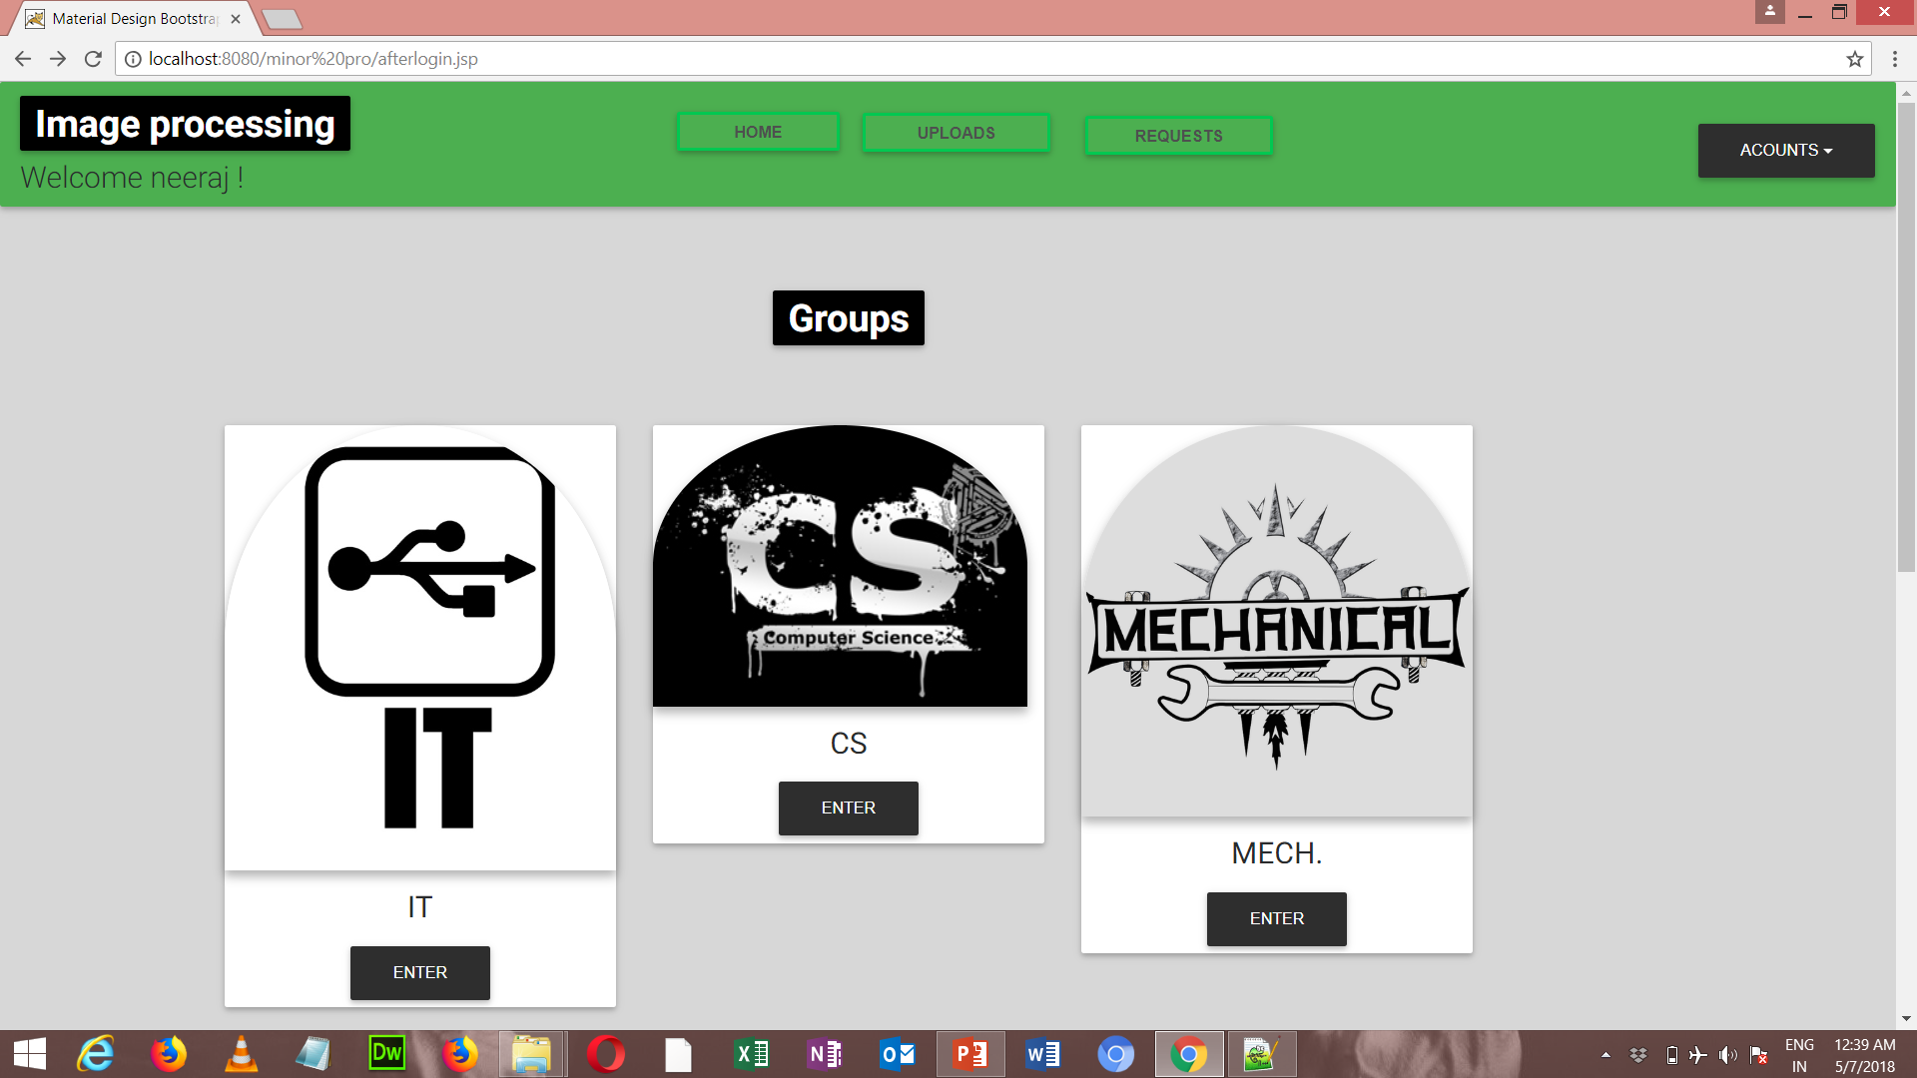
Select Group
After login now you are on your id and here on this page select a group according
To your branch in which you want to upload pictures.

Slide 14
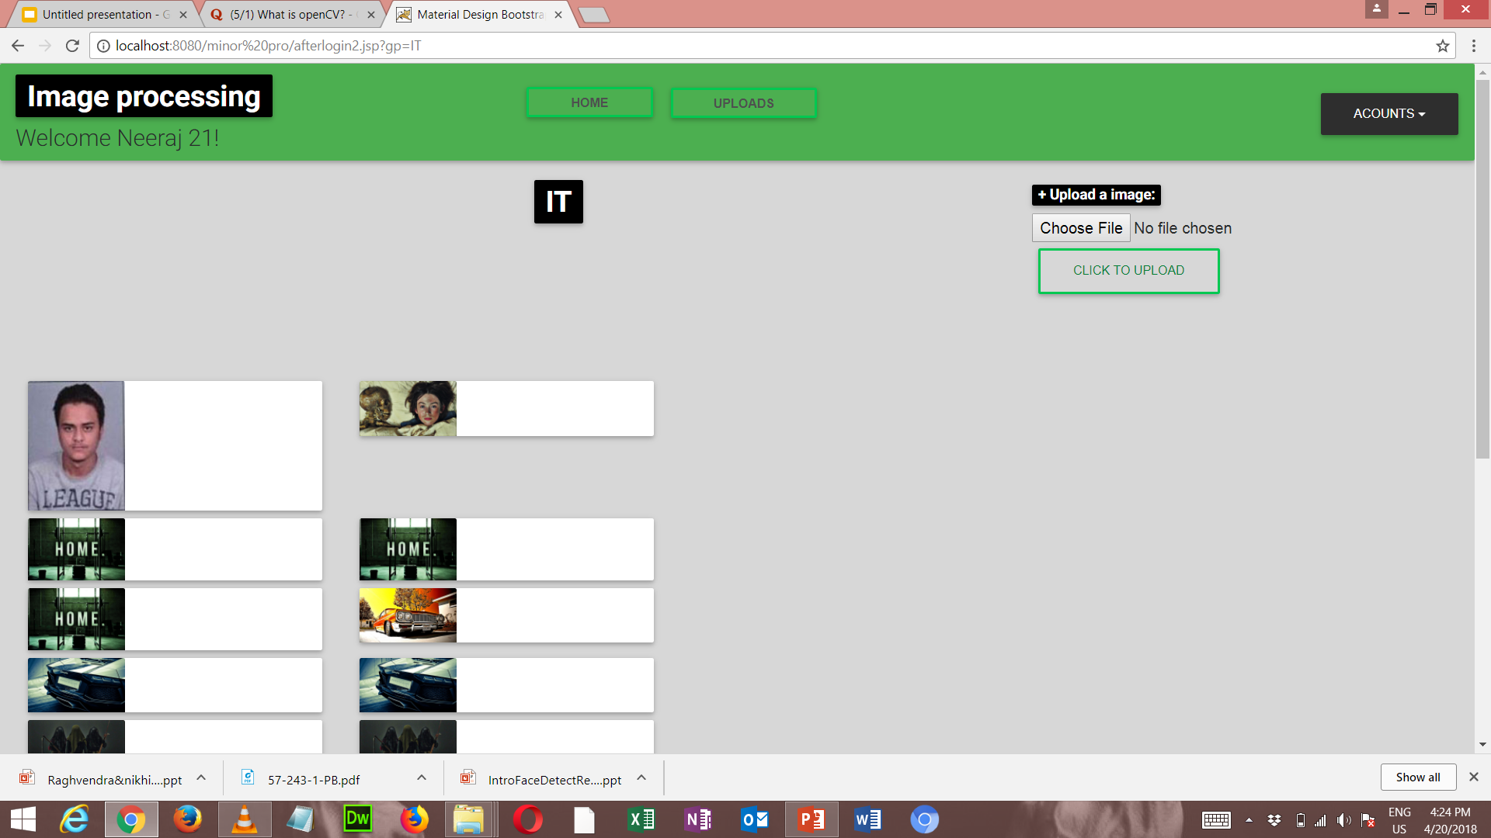
Upload Photos
Now upload photos of your college or events etc. to this page by clicking upload button .

Slide 15
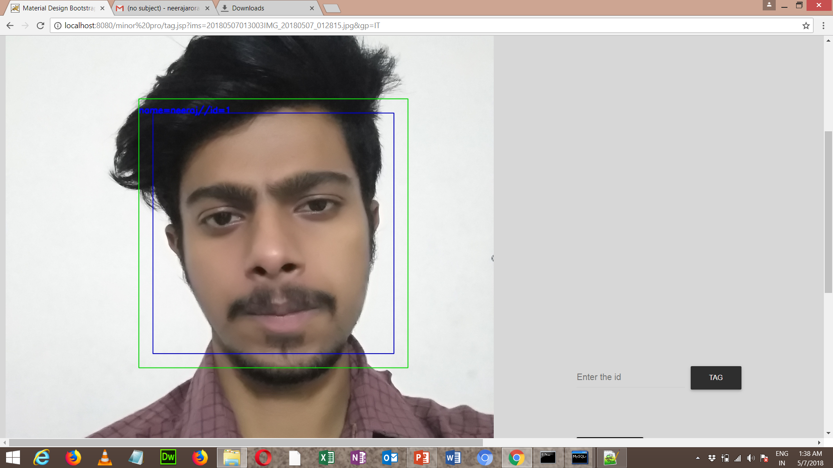
Once your photo is get uploaded you can tag peoples by entering their ids and id will
be automatically generated once face recognizer works.Tag can be made only once tagged
People approve your tag request.

Slide 16
Admin Section
Admin of the website are registered by directly filling
entries on database.
2. Login as admin .
3. Check out the users uploaded pictures.
4. Recognize and detect faces of various users with the help of
OpenCV library.
5. Admin can delete and add new users.

Slide 17
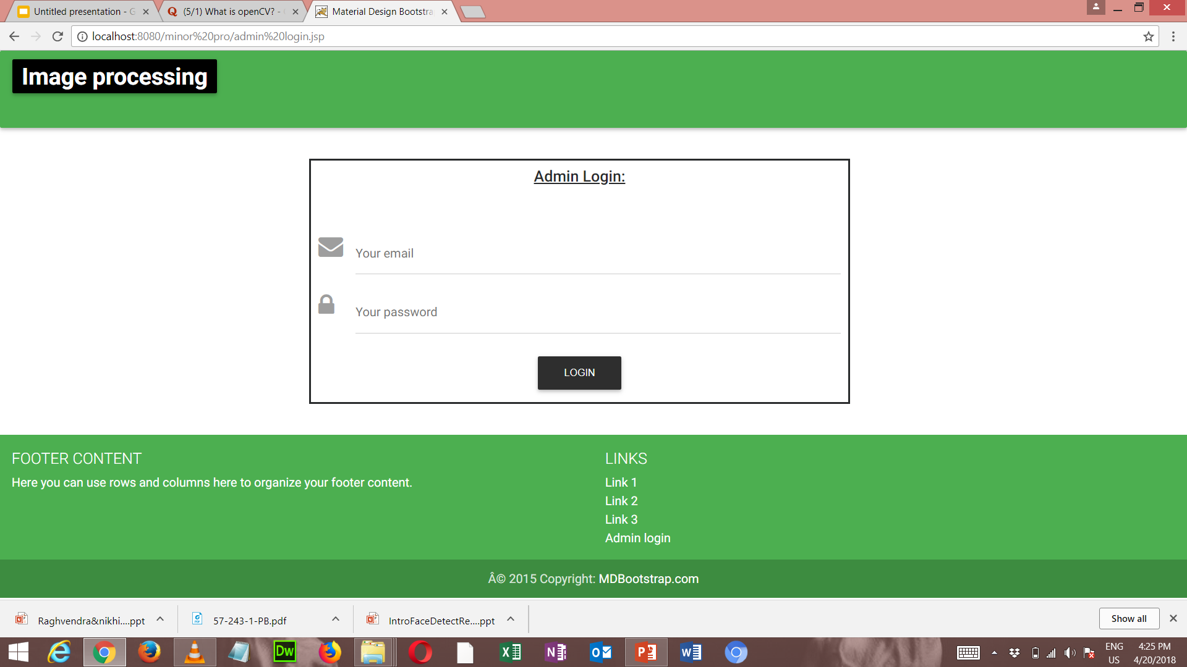
Admin Section

Slide 18
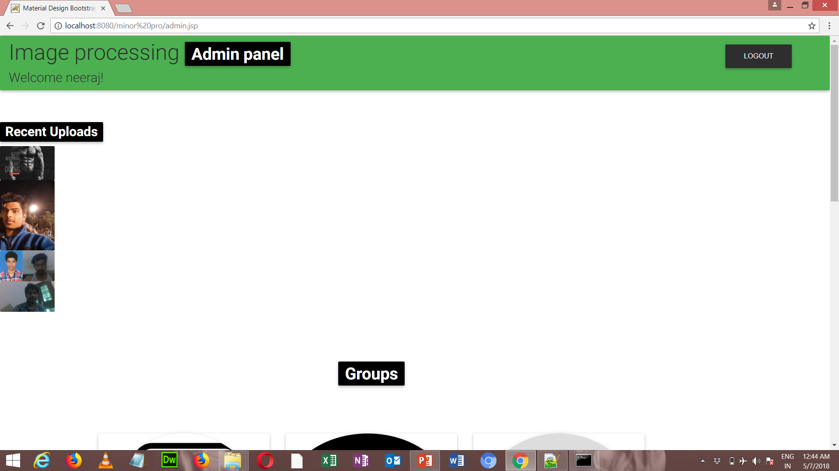
Once you login as admin welcome to this home page of the admin which shows recent
Uploads and admin can also see the uploaded photos in the group wise manner.

Slide 19


Slide 20
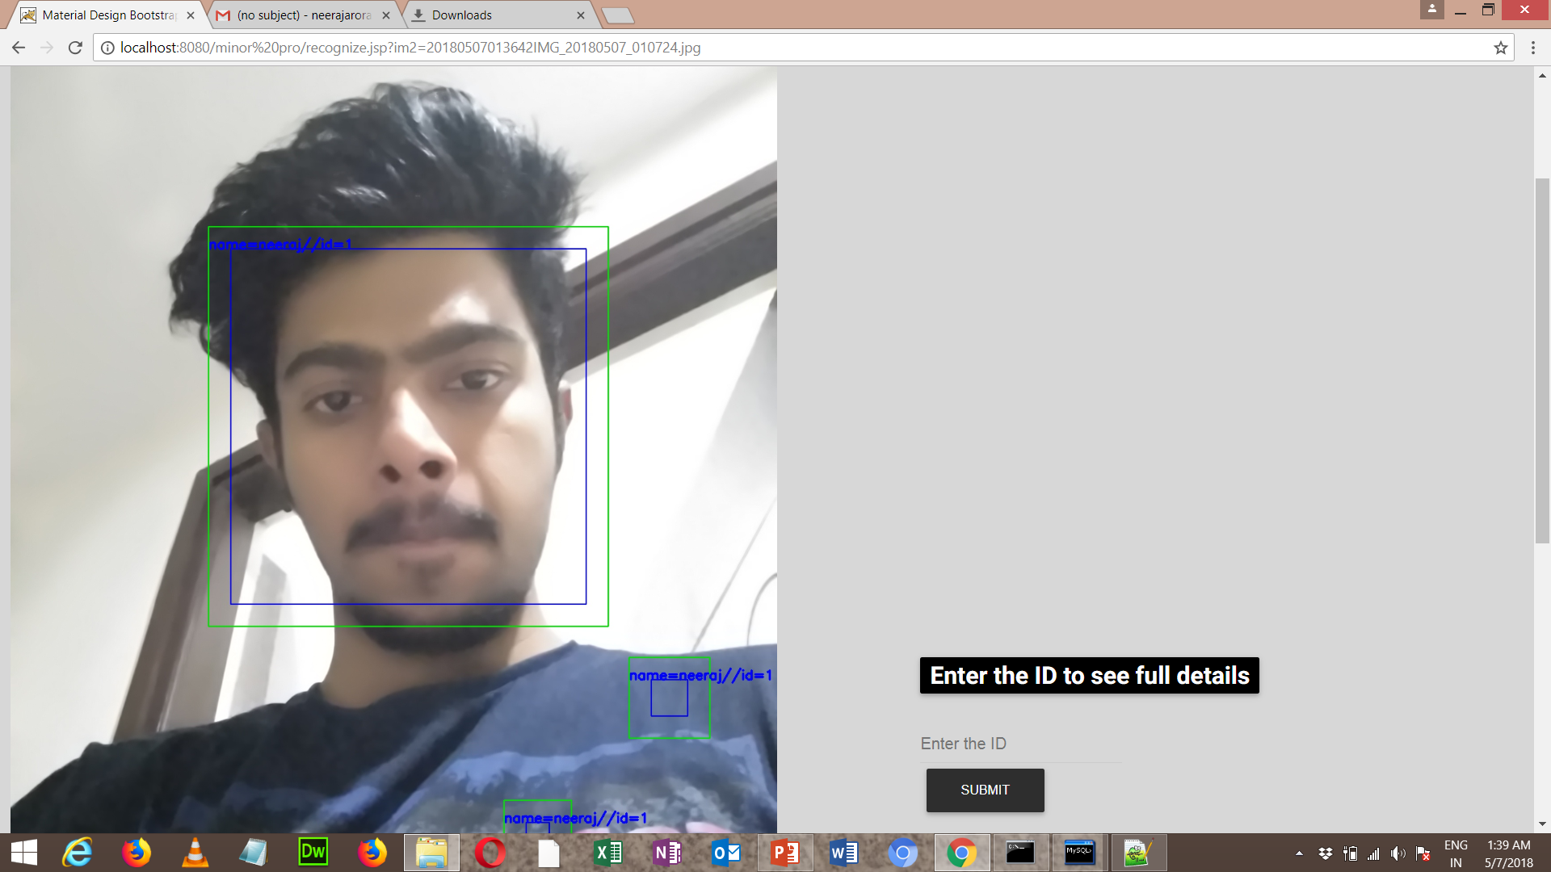
Opencv Face recognition automatically gives you the id and person name and
Now at this stage admin can easily fetch details.

Slide 21
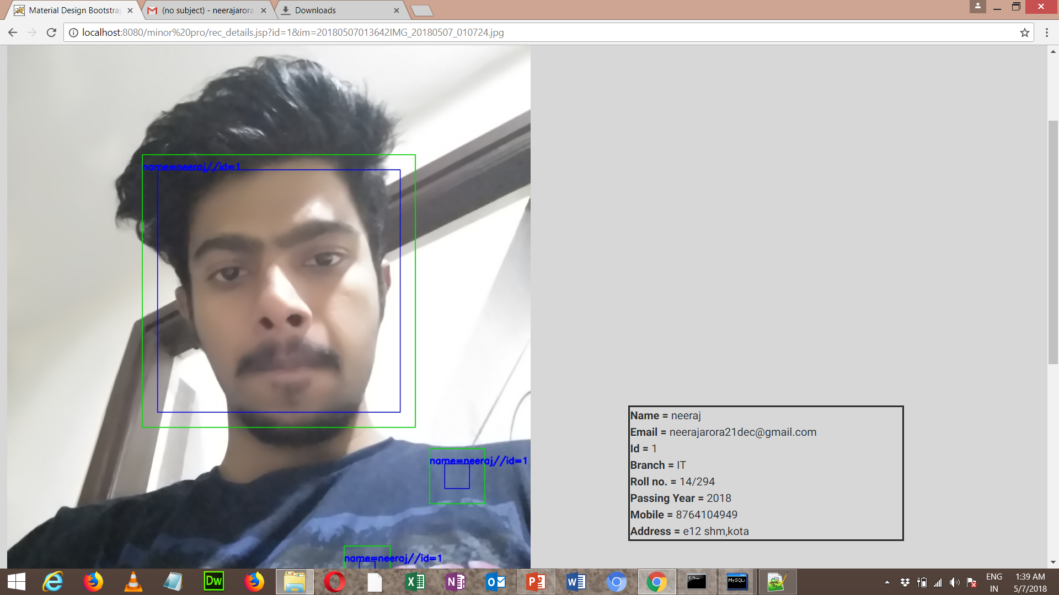
Details of the face person

Slide 22
How OpenCV is Working ?
Training the data
The more images used in training the better. Normally a lot of images are used for training a face recognizer so that it can learn different looks of the same person, for example with glasses, without glasses, laughing, sad, happy, crying, with beard, without beard etc.
So when user upload the pictures OpenCV detect the faces from the images.We are using OpenCV's **LBP face detector**.
On the next page see how data get trained.

Slide 23
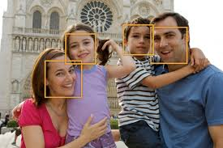
On the stage of registeration at user level , user need to upload picture of him or her
Atleast five pictures there those pictures got stored the database and HaarCascade
Classifier can detect faces among the photos like this way as shown below.

Slide 24
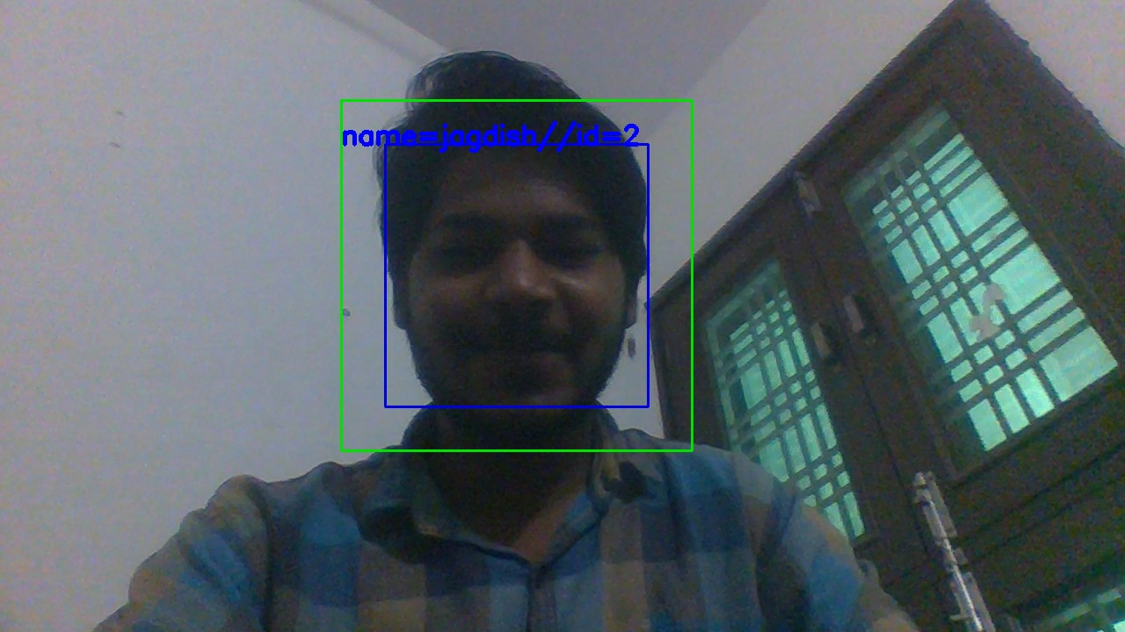
Then OpenCV face recognizer(we are using LBP face recognizer extract facial fetaures
from the uploads and Store them in recognizer with a userid and whenever we execute the
Recognizer script written in python it test all the images which are uploaded by users and
Show them like this as shown below.

Slide 25
Advantages of this website
1. Alumni's of the college can see their photos after a long period of time.
2. Users can upload pictures by acting anonymous and tag the people
by sending a tag request.
3. Admin can easily recognize faces and get details of any alumni
with in seconds with OpenCV library.

Slide 26



References
https://opencv.org/
https://www.tutorialspoint.com/index.htm
https://www.w3schools.com/
https://www.python.org

Slide 27
Project Team
Neeraj Arora (14/294)
Jagdish Verma (14/288)
Nikhil Gurjar (14/295)
THANK YOU

